Slide 1
Methods for solving ordinary differential equations
Wissam Razouki
CSE 3802

Slide 2
Background

Slide 3
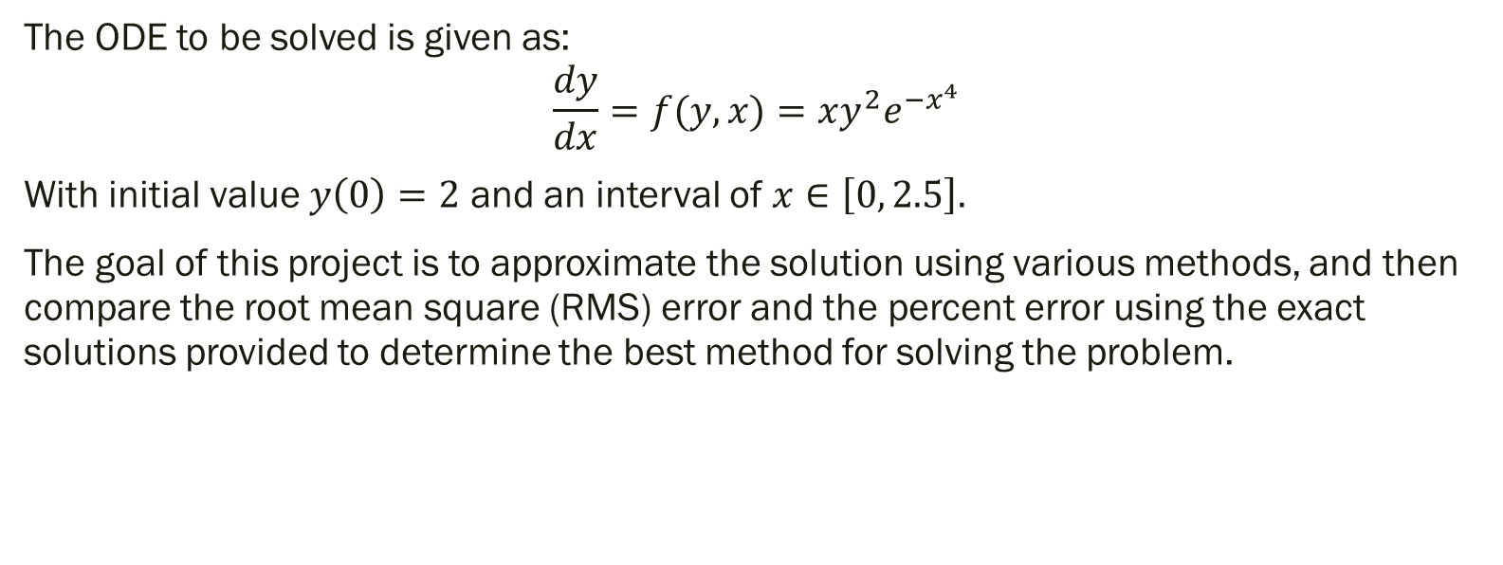
Introduction
The ODE to be solved is given as:
$$\frac{dy}{dx}=f(y,x)=xy^{2}e^{−x^{4}}$$
With initial value $y\left(0\right)=2$ and an interval of $x∈\left[0, 2.5\right].$
The goal of this project is to approximate the solution using various methods, and then compare the root mean square (RMS) error and the percent error using the exact solutions provided to determine the best method for solving the problem.

Slide 4
Methods Used
Reference method:
The exact solution
Experimental methods:
Euler’s method
Runge-Kutta 4th order method (RK4)
Modified Euler method

Slide 5
Methods and verification

Slide 6
Experimental Methods
Euler’s method
First-order method
Considered the most basic method for predicting solutions to ODEs
Approximations are generated at various values within the interval
Runge-Kutta 4th order method (RK4)
A 4th order method that has the high-order local truncation error of the Taylor methods, but without the need to compute derivatives
Modified Euler method
A predictor-corrector method that modifies the Euler method by adding a corrector term after predicting the solution

Slide 7
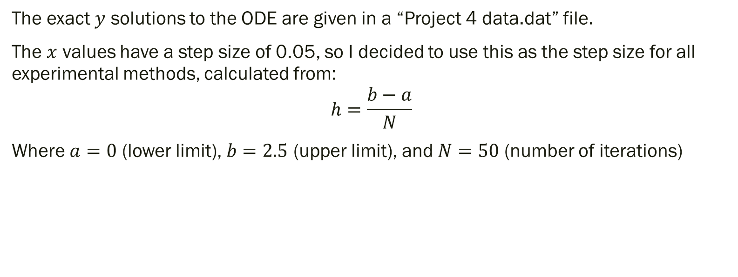
Step Size
The exact $y$ solutions to the ODE are given in a “Project 4 data.dat” file.
The $x$ values have a step size of 0.05, so I decided to use this as the step size for all experimental methods, calculated from:
$$h=\frac{b−a}{N}$$
Where $a=0$ (lower limit), $b=2.5$ (upper limit), and $N=50$ (number of iterations)

Slide 8
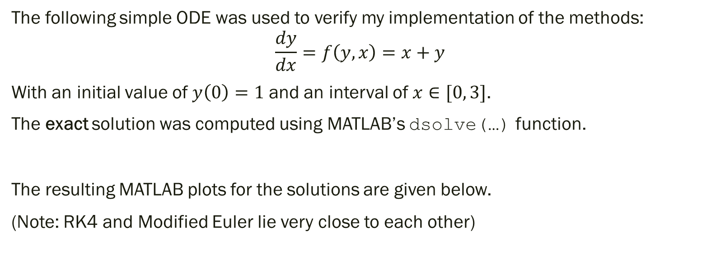
Method Verification
The following simple ODE was used to verify my implementation of the methods:
$$\frac{dy}{dx}=f\left(y,x\right)=x+y$$
With an initial value of $y\left(0\right)=1$ and an interval of $x∈[0, 3]$.
The exact solution was computed using MATLAB’s dsolve(…) function.
The resulting MATLAB plots for the solutions are given below.
(Note: RK4 and Modified Euler lie very close to each other)

Slide 9
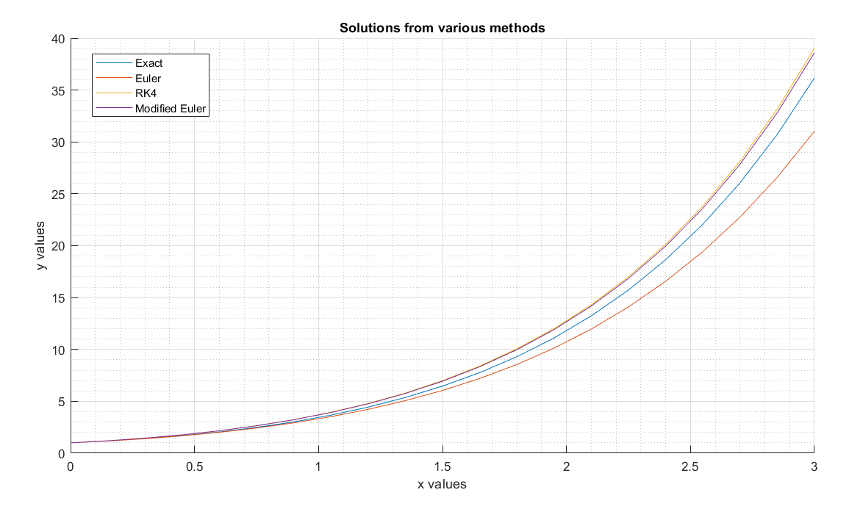

Slide 10
Results and analysis

Slide 11
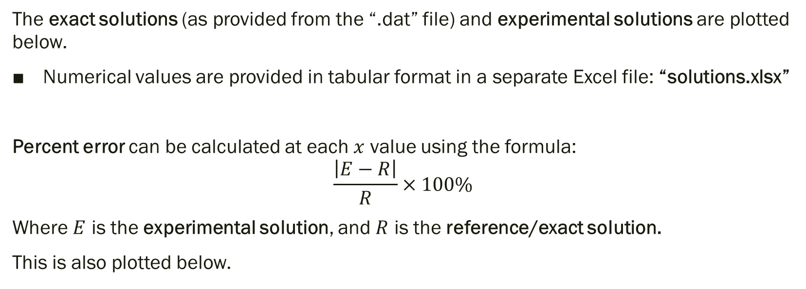
Solutions and Percent Error
The exact solutions (as provided from the “.dat” file) and experimental solutions are plotted below.
Numerical values are provided in tabular format in a separate Excel file: “solutions.xlsx”
Percent error can be calculated at each $x$ value using the formula:
$$\frac{\left|E−R\right|}{R}×100\%$$
Where $E$ is the experimental solution, and $R$ is the reference/exact solution.
This is also plotted below.

Slide 12
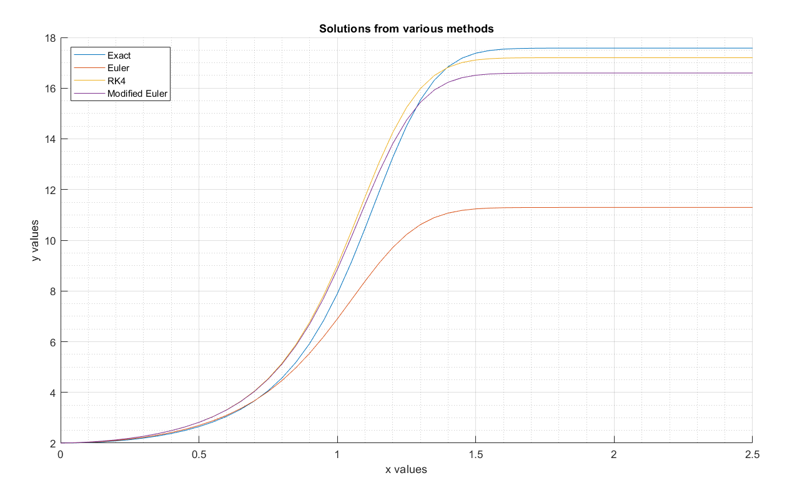

Slide 13
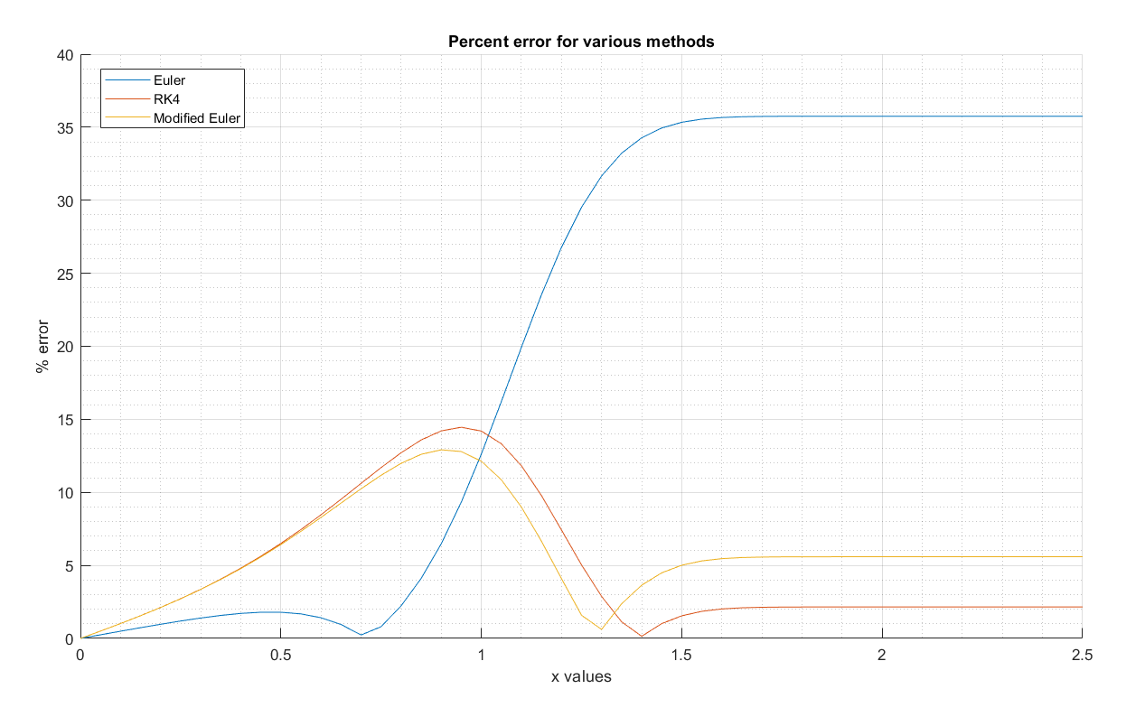

Slide 14
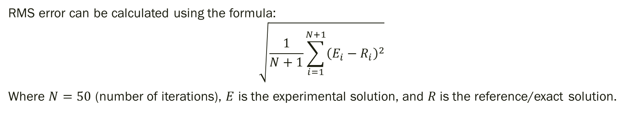
RMS Error
RMS error can be calculated using the formula:
$$\sqrt{\frac{1}{N+1}\sum_{i=1}^{N+1}{{\left(E_{i}−R_{i}\right)}^{2}}}$$
Where $N=50$ (number of iterations), $E$ is the experimental solution, and $R$ is the reference/exact solution.
Method | RMS error
Euler | 4.4197
RK4 | 0.5137
Modified Euler | 0.7343

Slide 15
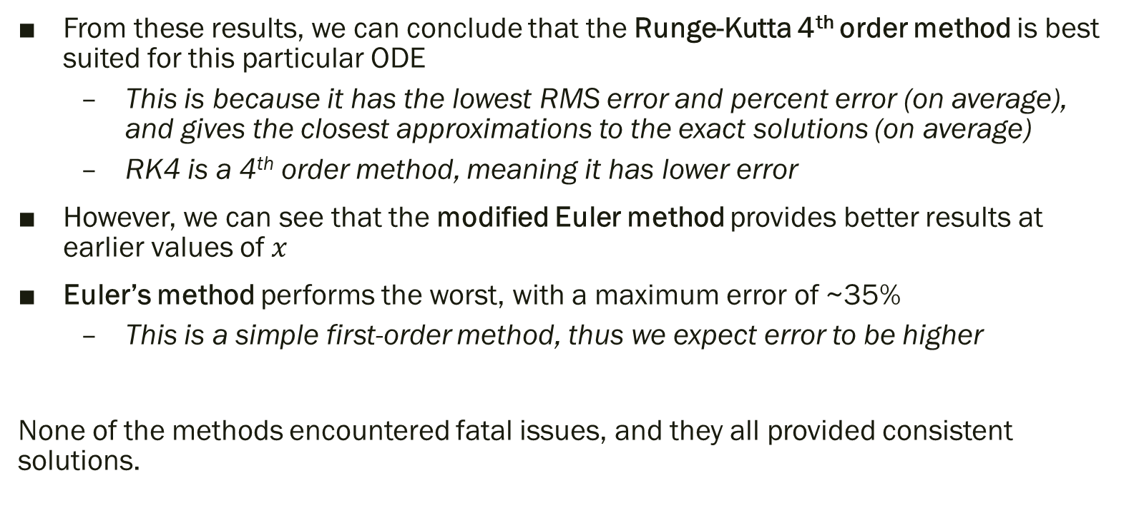
Analysis and Conclusions
From these results, we can conclude that the Runge-Kutta 4th order method is best suited for this particular ODE
This is because it has the lowest RMS error and percent error (on average), and gives the closest approximations to the exact solutions (on average)
RK4 is a 4th order method, meaning it has lower error
However, we can see that the modified Euler method provides better results at earlier values of $x$
Euler’s method performs the worst, with a maximum error of ~35%
This is a simple first-order method, thus we expect error to be higher
None of the methods encountered fatal issues, and they all provided consistent solutions.

